Slide 1
NEMS planning Part 2
LBHB Lab Meeting
August 17, 2017

Slide 2
Next month
schedule this month
Stephen vacation Aug 21-25
DARPA YFA meeting - Stephen Aug 29-31(am)
Retreat (Daniela, Jesyin, Mateo, Charlie, and ?) – Sep 11
ICAC Stephen & Luke out Sep 11-15
Surgery
Boleto VNS implant Sep 4-8?
Fred perfusion Sep 4-8?

Slide 3
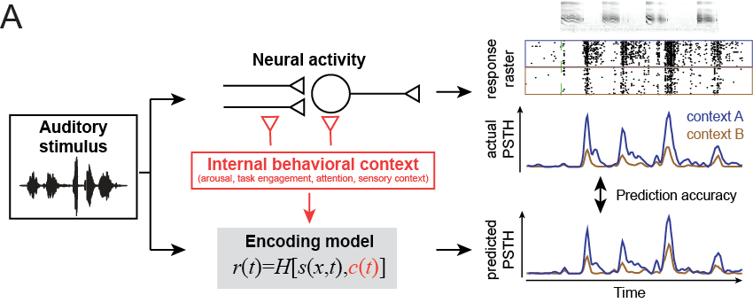

Encoding Models
$$r_{i}\left(t\right)=h_{i}\left[S\left(t\right)\right]$$
Time-varying response as a function of the incoming stimulus:
Wu et al. 2006; Thorson & David 2015

Slide 4
State-dependent encoding models
Behavior-independent model
Behavior-dependent model

Slide 5
Integrating behavioral state into encoding models
How accurately do behavior-dependent models describe neural activity?
What does the pattern of behavioral effects reveal about neural algorithms?
Can we link behavioral changes to physiological mechanisms?

Slide 6
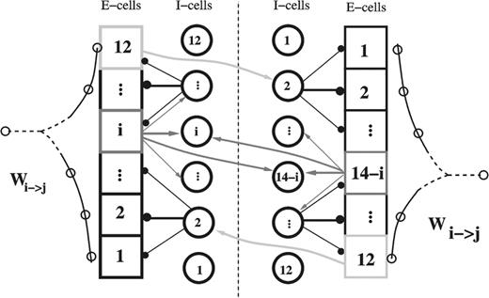
What is a behavioral state?
Option 1: Discrete changes in recurrent network activity
State = switch between stable attractor by a modulatory trigger
Classic psychology design
CS+/CS- (Bakin & Weinberger 1996)
Passive/active (Fritz et al. 2003)
Spatial vs. spectral (Rodgers & DeWeese 2014)
Moving/quiescent (Schneider et al. 2014)
Auditory/visual (Williamson et al. 2015)
Attend feature A vs. B (Downer et al. 2017)
(Miller et al. 2003)
A
Neuron 2
B
Neuron 1

Slide 7
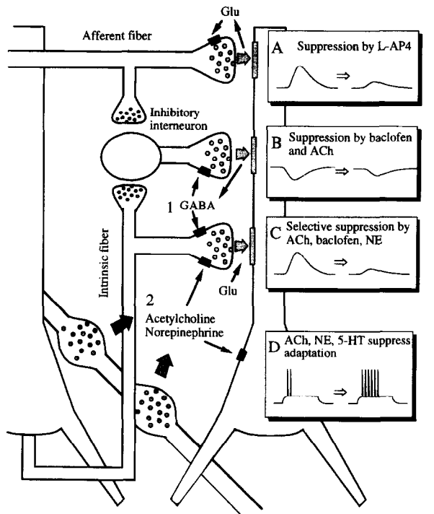
What is a behavioral state?
Option 2: Continuous changes in neuromodulatory tone
State = Synaptic weights of auditory filters altered by transient neuromodulation
Smooth changes in behavioral state
Arousal (McGinley et al. 2015)
Hippocampal state (Aranov et al. 2017)
Sensory context
SNR of noise (Rabinowitz et al. 2013)
Degree of adaptation (Ulanovsky et al. 2003)
(Hasselmo 1995)

Slide 8
A continuum of behavioral state(s)
Sensory inputs
(many* bits)
Brain
Motor outputs
(a few bits)
}
Evoked activity
larger
faster
Network state
Spatial scale
Temporal scale
Neuromodulators
Context
Synaptic weights
smaller
slower
Genes
* In theory, the auditory nerve can encode 10³⁶⁰ different 1-second sounds. The universe is about 10¹⁸ seconds old.

Slide 9
Models with discrete and continuous state
Behavior-independent model
Full discrete model
Partial discrete model
Partial continuous model

Slide 10
Who cares about state-dependent models?
Daniela
passive vs. active, easy vs. hard (discrete)
Zack
pupil (continuous)
pupil & behavior (hybrid continuous+discrete)
Mateo
jittered vs. non-jittered SSA (discrete)
Charlie
network (latent) state (continuous)
Jesyin
VNS vs. no VNS (discrete)
learning trajectory (continuous)
Luke
Coherent vs. incoherent, attention (discrete)

Slide 11
NEMS – all the parts

Slide 12
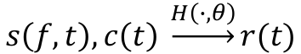
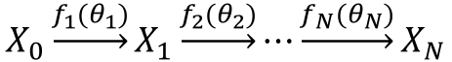
Core – the model engine
Basic model:
$$s\left(f,t\right), c\left(t\right) \underset{→}{H\left(∙,θ\right)}r(t)$$
“Engine”:
$$X_{0}\underset{→}{f_{1}(θ_{1})}X_{1}\underset{→}{f_{2}(θ_{2})}⋯\underset{→}{f_{N}(θ_{N})}X_{N}$$
Starting point:
stimulus – s(f, t, stimidx) – call this x₀
response – r(t, rep, stimidx)
pupil – p(t, rep, stimidx)
“state” (attention, VNS, etc) - c(t, rep, stimidx) (state usually changes slowly between blocks, but could change quickly)
Things to fit at each stage, x_{i+1}=f_{i}(x_{i}, θ_{i}):
STRF : h(f, u), θ=STRF weights + baseline x_{i+1}=h(f, u) * x_{i}
State-dependent STRF: h₁(f, u) if c=1 h₂(f, u) if c=2, etc.
Pupil-dependent gain:

Slide 13
To-dos from last time, mostly done!
Model engine
Standard module format
Integrate contextual variables (behavior state, pupil)
Nested cross-validation
Fitter
Simple gradient descent
Iterative fitters
Integrate with fancy fitters (eg, theano)
Web-based model & results browser, fit launcher
Communicate data file information, pre-processing to fitter
Model visualization tool (narf_modelpane)
Link to cluster for fitting large datasets
User specific batches, data sets
Data upload/management
Preprocessing – Matlab-to-Python data conversion
narf/queue/export_cellfile.m: generates mat file in nems_in_queue/batchXXX/ that can be read by NEMs and is shared on the Amazon S3 cloud
nems.utilities.baphy_utils.load_baphy_file: reads mat file into a python dictionary

Slide 14
Stuff that needs to be done
X₀
Handling state variables
Several pieces of code are specifically designed for “pupil” need to generalize and allow multiple state variables
Splitter/uniter
branch flow of data through stack depending on value of discrete state variable (attention, jitter, noise, VNS, etc)
Population data loader
Load all cells from a single experiment or batch
For latent state analysis and/or stimulus reconstruction
s=?
X₁, s=1
X₁, s=2
H₁(f,u)
H₂(f,u)
X₂
Prediction
accuracy?

Slide 16
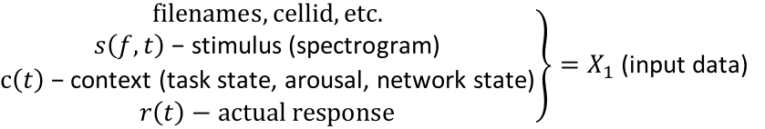
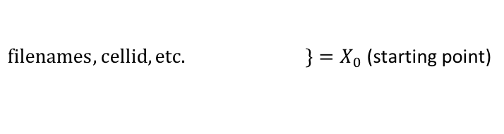
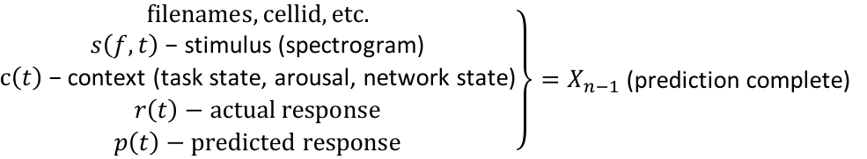
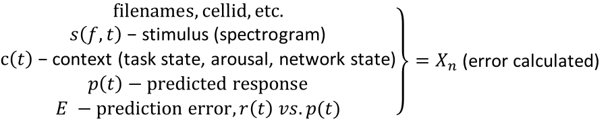
Core – the model engine
Basic model:
$$s\left(f,t\right), c\left(t\right) \underset{→}{H\left(∙,θ\right)}r(t)$$
“Engine”:
$$X_{0}\underset{→}{f_{1}(θ_{1})}X_{1}\underset{→}{f_{2}(θ_{2})}⋯\underset{→}{f_{N}(θ_{N})}X_{N}$$
$\left.filenames, cellid, etc. \right\}=X_{0}$ (starting point)
Load module – or make this pre-processing?
$\left.\begin{matrix}filenames, cellid, etc. \\ s\left(f,t\right)\text{ − }\text{stimulus}\text{ (}\text{spectrogram}\text{)} \\ \begin{aligned}c\left(t\right)\text{ − }\text{context}\text{ (}\text{task} \text{state}\text{, }\text{arousal}\text{, }\text{network} \text{state}\text{)} \\ r\left(t\right)−actual response\end{aligned}\end{matrix}\right\}=X_{1}$ (input data)
Filter module(s) – require free parameters (𝛉)
$\left.\begin{matrix}filenames, cellid, etc. \\ s\left(f,t\right)\text{ − }\text{stimulus}\text{ (}\text{spectrogram}\text{)} \\ \begin{aligned}c\left(t\right)\text{ − }\text{context}\text{ (}\text{task} \text{state}\text{, }\text{arousal}\text{, }\text{network} \text{state}\text{)} \\ r\left(t\right)−actual response \\ p\left(t\right)−predicted response\end{aligned}\end{matrix}\right\}=X_{n−1}$ (prediction complete)
Error calculation module(s)
$\left.\begin{matrix}filenames, cellid, etc. \\ s\left(f,t\right)\text{ − }\text{stimulus}\text{ (}\text{spectrogram}\text{)} \\ \begin{aligned}c\left(t\right)\text{ − }\text{context}\text{ (}\text{task} \text{state}\text{, }\text{arousal}\text{, }\text{network} \text{state}\text{)} \\ p\left(t\right)−predicted response \\ E −prediction error, r\left(t\right) vs. p(t)\end{aligned}\end{matrix}\right\}=X_{n}$ (error calculated)

Slide 17

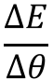
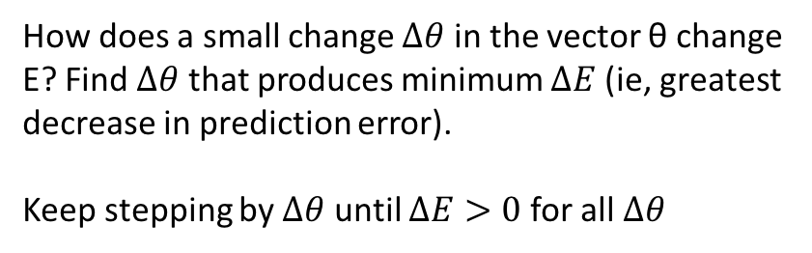
Core – the fitter
Basic model:
$$s\left(f,t\right), c\left(t\right) \underset{→}{H\left(∙,θ\right)}r(t)$$
Engine:
$$X_{0}\underset{→}{f_{1}(θ_{1})}X_{1}\underset{→}{f_{2}(θ_{2})}⋯\underset{→}{f_{N}(θ_{N})}X_{N}$$
Fitter: Choose values of θ for which the engine produces the minimum prediction error.
$E={\left\langle {\left(r\left(t\right) −p(t)\right)}^{2}\right\rangle }_{t}$ = (average square difference between response and prediction)
Gradient :
$$\frac{∆E}{∆θ}$$
How does a small change $∆θ$ in the vector θ change E? Find $∆θ$ that produces minimum $∆E$ (ie, greatest decrease in prediction error).
Keep stepping by $∆θ$ until $∆E>0$ for all $∆θ$

Slide 18
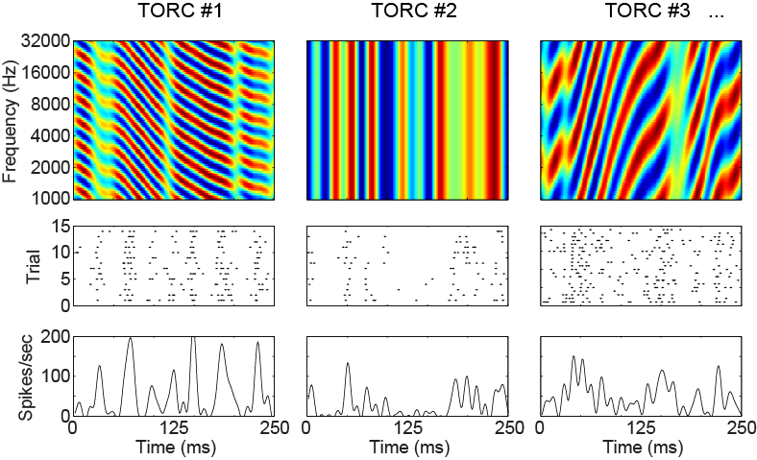
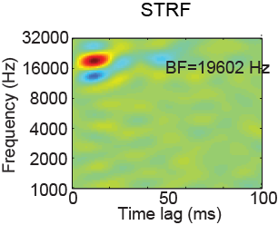
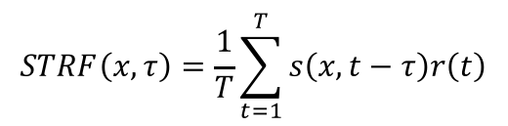
Linear STRF engine requires three modules
…
+
+
+
+
+
…
Spike-triggered average
$$STRF\left(x,τ\right)=\frac{1}{T}\sum_{t=1}^{T}{s\left(x,t−τ\right)r\left(t\right)}$$
Load
FIR
MSE

Slide 19
model_name / keyword sequences
Model_name = “key1_key2_..._keyN”
Fitting: execute sequence key1, then key2, … then keyN
keyX is a function that can do anything, eg:
Add one or more modules to stack
Set parameters or hyperparameters
Run a fit algorithm
Eg: fb18ch100_lognn_wcg03_adp1pc_ap3z1_siglog100_fit05c
fb18ch100 – load 18 channel spectrogram, 100 Hz sampling rate
lognn – perform compression on spectrogram (1 free parm)
wcg03 – Gaussian spectral weighting to three channesl (6 free parms)
adp1pc– synaptic depression or facilitation for each of the (three) channels (3 free parms)
ap3z1– FIR pole-zero filter (4 free parms)
siglog100 – logistic sigmoid (5 free parms)
fit05c – iterative coordinate descent until 𝛥E < 10^-6

Slide 20
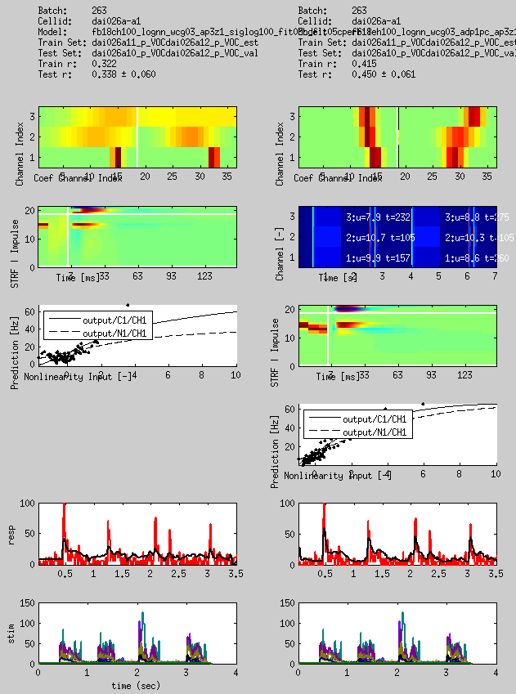
Core – visualization
Spectral filter parameters
Synaptic depression parameters
FIR filter parameters
Static nonlinearity input vs. output
Predicted vs. actual response

Slide 21
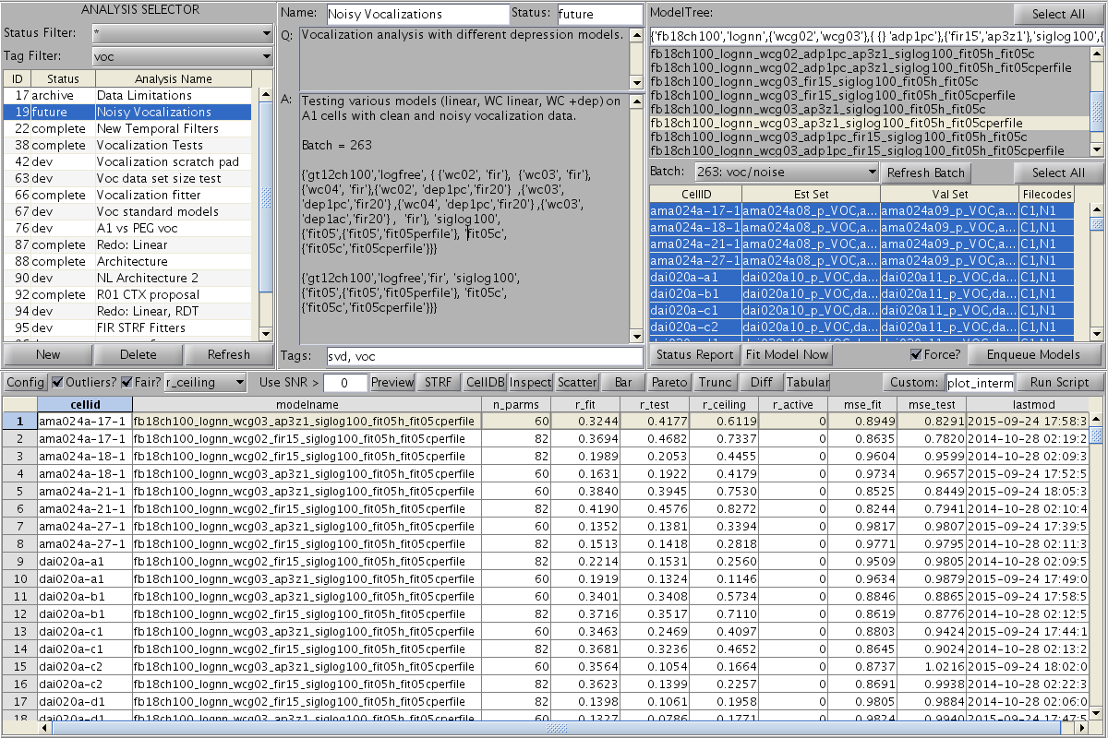
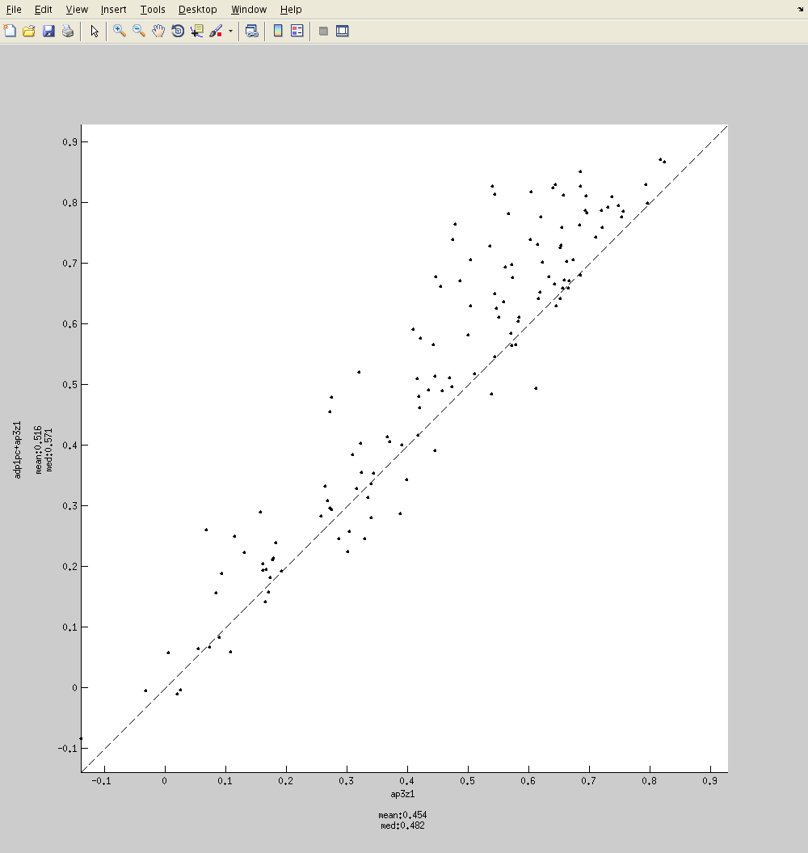
Core - browser

Slide 22
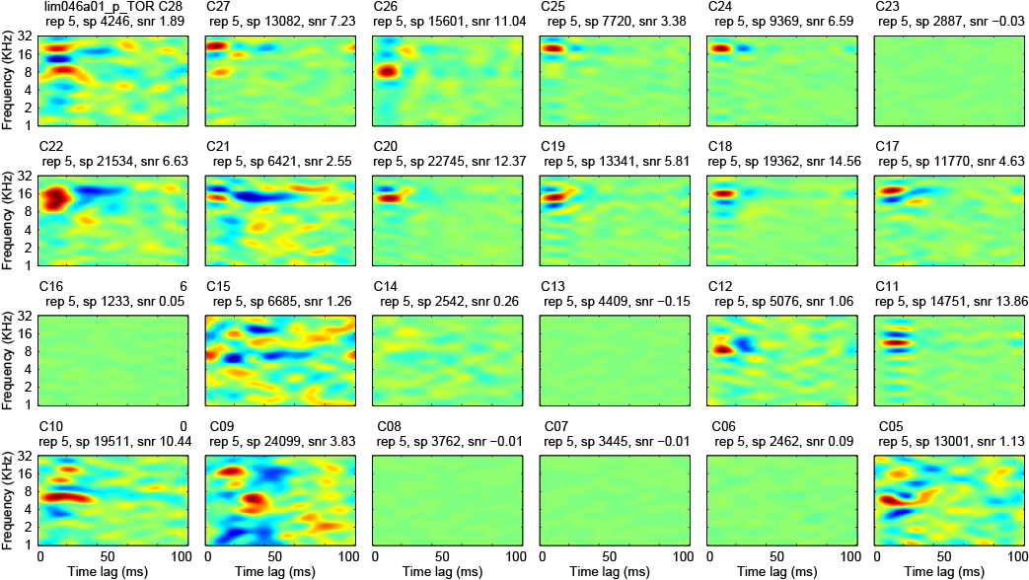
A bunch of FIR matrices for A1 TORC STRFs
STRFs for 24 channels recorded simultaneously in A1/AAF using a fixed array of platinum-iridium electrodes.

